Slide 1
Week 2 Arrays and ArrayLists
This presentation makes extensive use of animations and should be viewed in presenter mode (Shift+F5). It has been configured to open in windowed mode, so you can view it alongside other windows.

Slide 2

Outline
Collections
Arrays
ArrayLists

Slide 3
Collections
Collections
Arrays
ArrayLists

Slide 4

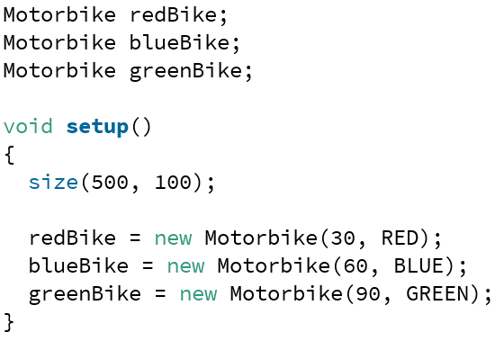
Collections
We have written a few applications now that have many similar ‘things’ in
We have been using individual variable names to refer to these (e.g redBike or bike1)
Collections
Arrays
ArrayLists

Slide 5
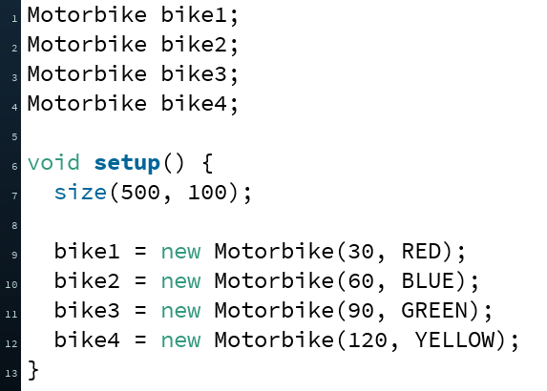
Collections
This is fine, but what if we need hundreds or thousands of the same type (e.g. 1000s of motorbikes)
We could make lots of individually named objects
But this is not a very good approach – each thing would result in more lines of code
Collections
Arrays
ArrayLists

Slide 6
Collections
What we need is a way to easily create and bunch together a large number of things of the same type
We can then iterate over them and perform tasks (e.g. printing out each value)
Programming 1 briefly mentioned the ArrayList (Week 6) – we will delve deeper this week
The simplest collection available in Java (and most languages) is the Array
Iterate over – visit each one of a collection in turn
Collections
Arrays
ArrayLists

Slide 7
Collections
Array: “A systematic arrangement of similar objects”
Fundamental data type – included in some form or other in most programming languages from the earliest days, from FORTRAN (1957) and LISP (1958) and onwards
Collections
Arrays
ArrayLists

Slide 8
We can create arrays to store primitives or objects
Recap: Types in Java
Types in Java
Primitive Types
Class Types
boolean
Numeric
Classes defined in the Java library
Classes we define
Integral
String
Motorbike
Floating-point
char
Scanner
Alien
byte
thousands of others
Student
long
float
double
short
int
Collections
Arrays
ArrayLists

Slide 9
Arrays
Collections
Arrays
ArrayLists

Slide 10
Arrays
The values in an array are referred to as elements
Elements must all be of the same type
This array contains 10 elements which are integers
Values
24 | 2 | 3 | 6 | 147 | 0 | -14 | 16 | 99 | -100
Collections
Arrays
ArrayLists

Slide 11
Arrays
Each value (element) in an array can be referenced through its index, which is of type int
Arrays are zero-based in Java – the first element is located at index 0
Index
0 | 1 | 2 | 3 | 4 | 5 | 6 | 7 | 8 | 9
Values
24 | 2 | 3 | 6 | 147 | 0 | -14 | 16 | 99 | -100
Collections
Arrays
ArrayLists

Slide 12
Arrays
All of the elements in an array are stored in one contiguous block in memory
Since ints are 4 bytes:
Index
0 | 1 | 2 | 3 | 4 | 5 | 6 | 7 | 8 | 9
Values
24 | 2 | 3 | 6 | 147 | 0 | -14 | 16 | 99 | -100
Memory location
1000 | 1004 | 1008 | 1016 | 1020 | 1024 | 1028 | 1032 | 1036 | 1040
Collections
Arrays
ArrayLists

Slide 13
Arrays
Creating an array is a two step process
Declare what data type the array will “hold”, followed by square brackets [ ] and give the array a name
Then we construct it using the array constructor, telling it how many elements we want
Or we can combine the declaration and initialisation in one line
// an array of integers
int[] intArray;
// construct an array of 10 integers
intArray = new int[10];
int[] intArray = new int[10];
Collections
Arrays
ArrayLists

Slide 14
Arrays
There is also another way to create arrays in Java
If you know (beforehand) the data that the array needs to ‘hold’, you can pass the data in after the array declaration
This is called an array initialiser – you are initialising the contents of the array as it is being declared
Note that we didn’t have to include the new keyword or specify the size – the size is inferred from the number of elements
String[] cities = {"London", "Manchester", "Liverpool", "Sheffield"};
float[] temperatures = {21.3f, 13.9f, 31.4f, 11.7f, 19.1f};
Collections
Arrays
ArrayLists

Slide 15
Arrays
Once an array has been allocated memory, it is of fixed size
Every array ‘knows’ its size through a length variable (accessed via arrayName.length)
Creating an array using the constructor (new keyword) causes an array to be created and filled with default values
0 for numeric types, false for boolean, null for objects
We can access the individual elements of an array by index using square brackets:
int[] intArray = new int[10];
intArray.length; // 10
intArray[0] = 14;
intArray[3] = 21;
0 | 1 | 2 | 3 | 4 | 5 | 6 | 7 | 8 | 9 | Index
 | 0 | 0 |  | 0 | 0 | 0 | 0 | 0 | 0 | Value
0
14
21
0
Collections
Arrays
ArrayLists

Slide 16
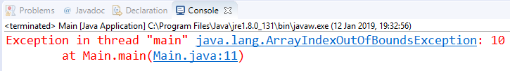
Arrays
Arrays have a lower and upper bound (indices we are able to access)
The lower bound is the first element (index 0)
The upper bound is the last element (arrayName.length – 1)
Attempting to access an index that does not exist causes an exception (an error in our code causing it to crash)
Many types of exceptions (see more later in the term)
ArrayIndexOutOfBounds – referencing an index that does not exist
0 | 1 | 2 | 3 | 4 | 5 | 6 | 7 | 8 | 9 | Index
 | 0 | 0 |  | 0 | 0 | 0 | 0 | 0 | 0 | Value
intArray[10] = 45;
14
21
Collections
Arrays
ArrayLists

Slide 17
Example Program
Create an array to hold the test scores of seven students. Populate it with values and calculate and print out the average grade.
Collections
Arrays
ArrayLists

Slide 18

testScores
0 | 1 | 2 | 3 | 4 | 5 | 6 | Index
72 | 65 | 68 | 40 | 52 | 80 | 45 | Value
length: 7
public class ArrayTest {
public static void main(String[] args) {
// declare an int array called testScores, and initialise with values
int[] testScores = {72, 65, 68, 40, 52, 80, 45};
int total = 0; // initialise total to zero
for (int i = 0; i < testScores.length; i++) {
// add the current score to the total
total += testScores[i]; // equiv to total = total + testScores[i];
}
float average = (float) total / testScores.length;
System.out.println("Average class grade: " + average);
}
}
137
205
245
297
377
422
0
total
72
7
2
1
0
3
6
4
i
5
average
60.285713
Collections
Arrays
ArrayLists

Slide 19
0 | 1 | 2 | Index
27.4 | 31.7 | 29.1 | Value
length: 3
temps
Can also go backwards (start from the end of the array, and loop to the front)
public class ArrayTest {
public static void main(String[] args) {
// declare an array of floats and initialise with values
float[] temps = new float[3];
temps[0] = 27.4f;
temps[1] = 31.7f;
temps[2] = 29.1f;
// loop through the array, starting from the back
for (int i = temps.length-1; i >= 0; i--) {
System.out.println(temps[i]);
}
}
}
Output
-1
0
2
i
1
29.1
31.7
27.4
Collections
Arrays
ArrayLists

Slide 20
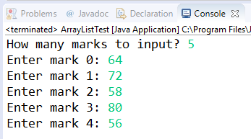
Dynamically Allocate Array Size
Can also dynamically allocate an array’s size during runtime
Prompt user to enter how many elements they need
import java.util.Scanner;
public class Main {
public static void main(String[] args) {
Scanner in = new Scanner(System.in);
System.out.print("How many marks to input? ");
int numMarks = in.nextInt();
int[] marks = new int[numMarks];
// read in marks
for (int index = 0; index < numMarks; index++) {
System.out.print("Enter mark " + index + ": ");
marks[index] = in.nextInt();
}
// after: calculate average and print etc
}
}
Collections
Arrays
ArrayLists

Slide 21
Arrays of Objects
class Student {
// very basic student class
String name;
int id;
}
We can also create arrays of Objects
In this case, the array will not “hold” the objects, but rather hold references to those objects
students
We’ve not created any Students yet, but an array which is capable of storing references to three student objects
class ArrayDemo {
public static void main(String[] args) {
Student[] students = new Student[3];
for (int i = 0; i < students.length; i++) {
students[i] = new Student();
}
}
}
0 | 1 | 2 | Index
 |  |  | Value
students[0]
students[1]
students[2]
3
name
null
name
null
name
null
2
1
i
0
id
0
id
0
id
0
Default values (since we’ve not specified our own constructor)
Collections
Arrays
ArrayLists

Slide 22
Arraylists
Collections
Arrays
ArrayLists

Slide 23
ArrayLists
Since arrays are fixed-size data structures, they cannot grow or shrink at runtime if you suddenly decide you need more space
You could create a new (bigger) array and copy your current array values to it..
Java provides a collection which can automatically grow/shrink during runtime – ArrayList
Provides more flexibility
As with arrays, we need to specify the type of objects we want to store, but we can’t use primitive types (e.g. float, int)
Collections
Arrays
ArrayLists

Slide 24
Example Program
Create an ArrayList to hold the test scores of students. While the user has not entered -1, keep prompting them for more grades. Calculate and print the average.
Collections
Arrays
ArrayLists

Slide 25
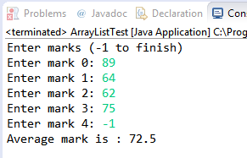
import java.util.ArrayList;
import java.util.Scanner;
public class ArrayListTest {
public static void main(String[] args) {
int enteredMark = 0;
int totalMark = 0;
int counter = 0;
Scanner in = new Scanner(System.in);
ArrayList<Integer> markList = new ArrayList<Integer>();
System.out.println("Enter marks (-1 to finish)");
while (enteredMark != -1) {
System.out.print("Enter mark " + counter + ": ");
enteredMark = in.nextInt();
if (enteredMark != -1) {
markList.add(enteredMark);
counter++;
}
}
// calculate total
for (int index = 0; index < markList.size(); index++) {
totalMark += markList.get(index);
}
// print average
System.out.println("Average mark is : " + (float) totalMark / markList.size() );
}
}
Import the ArrayList class.
Declare and construct an ArrayList of Integer objects (note Integer is the ‘object’ version of int). Type is in angle brackets.
Counter being used & incremented to display current mark being entered to the user.
add() method adds an item at the end of the list.
size() method gives number of items.
get() method returns the item at the specified index in the list.
Casting one variable to a float to ensure a float is returned
Collections
Arrays
ArrayLists

Slide 26
ArrayList Method Summary
ArrayList<String> names = new ArrayList<>();
names.add("Bob");
names.add("Alice");
names.add("John");
0 | 1 | 2
Bob | Alice | John
ArrayList Method | Description | Example | Result
add ( item )
Add item to the end of the list
0 | 1 | 2 | 3
Bob | Alice | John | Marie
names.add("Marie");
get ( index )
Gets an item at an index
names.get(1);
Alice
set ( index, item )
Updates the slot at index with the new value item
0 | 1 | 2 | 3
Robert | Alice | John | Marie
names.set(0, "Robert");
indexOf( item )
Returns the index of the first occurrence of item in the list (returns -1 if not found)
names.indexOf("John");
2
Collections
Arrays
ArrayLists

Slide 27

Summary
Collection – A “systematic arrangement of things”
Those things could be primitive types (e.g. int, float), or objects (e.g. String, Motorbike)
In the case of objects, a collection will store the reference to the objects – not the objects themselves
Array – fixed-size data structure
ArrayList – dynamic data structure that can grow/shrink as the program is running
Collections
Arrays
ArrayLists

